Slide 1
IPV6
WAN PART FOUR By :
Eng.k.awdallah

Slide 2
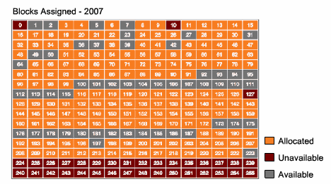
IPv4

Slide 3
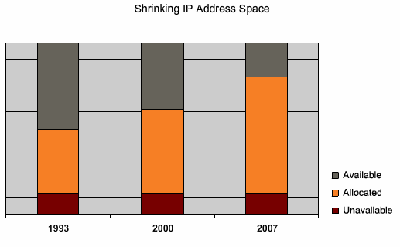
IPv4

Slide 4
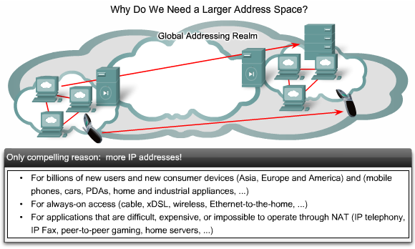
IPv6

Slide 5
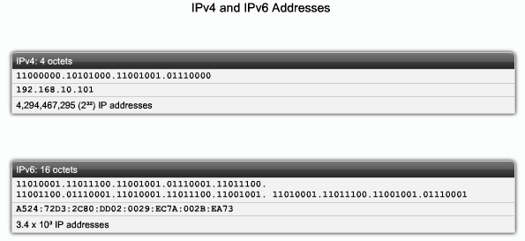
IPv4 vs IPv6

Slide 6
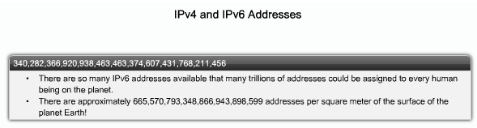
IPv4 vs IPv6

Slide 7
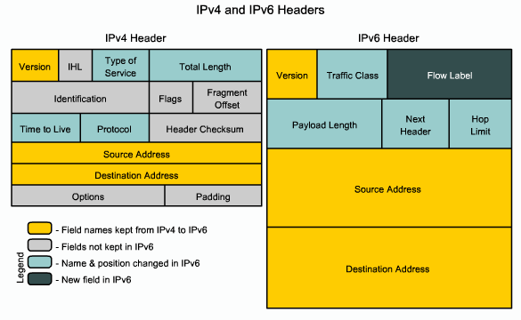
IPv6 header

Slide 8
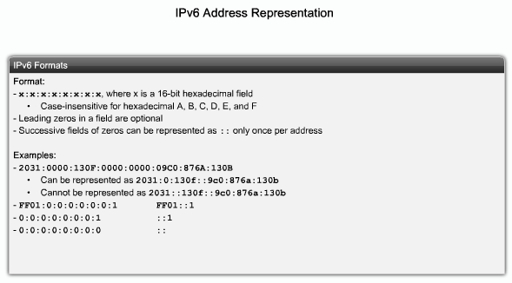
IPv6 format

Slide 9
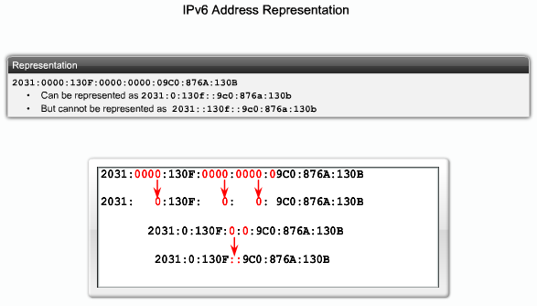
IPv6 representation

Slide 10
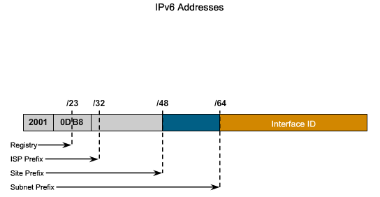
IPv6 address

Slide 11
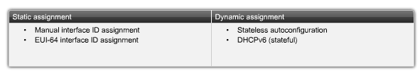
Assigning IPv6 address

Slide 12
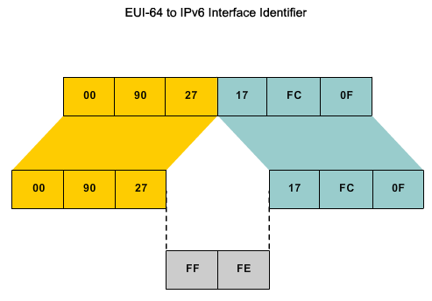
EUI-64 to IPv6

Slide 13
IPv4 with IPv6
Now the development of networks with IPv6 will be step by step so networks will be in between of IPv6 & IPv4
The issue now is how to make communication between IPv6 & IPv4 networks (IPv6 transition strategies)

Slide 14
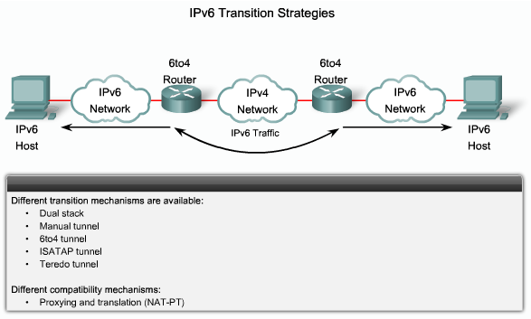
IPv6 Transition Strategies

Slide 15
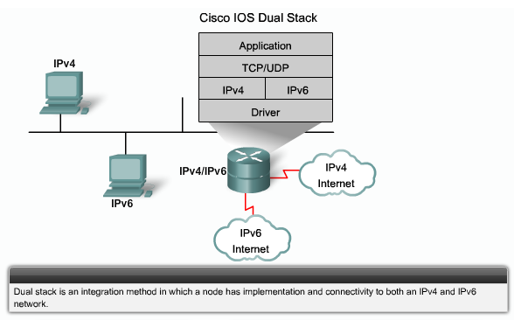
Dual stack

Slide 16
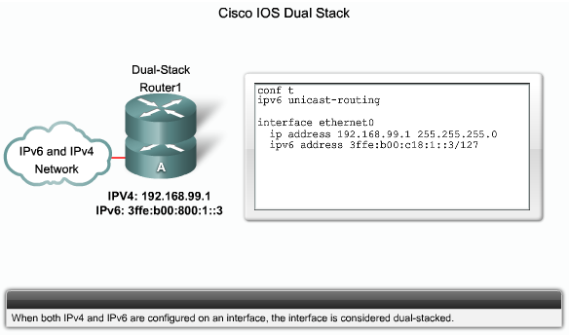
Dual stack

Slide 17
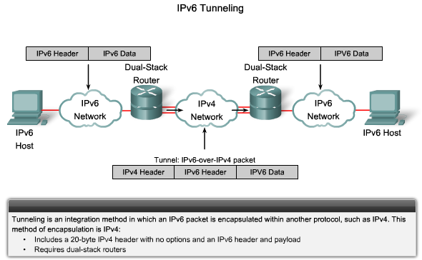
IPv6 tunneling

Slide 18
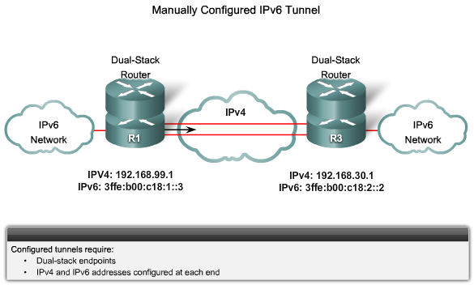
IPv6 tunneling

Slide 19
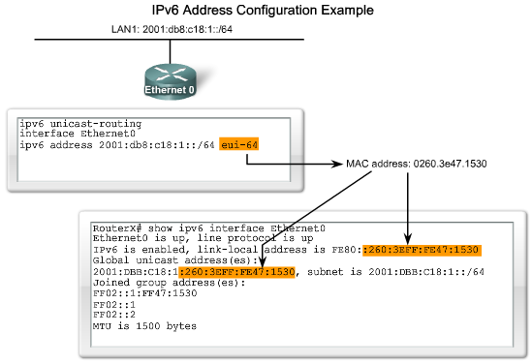
Configuring IPv6

Slide 20
IPv6 routing protocols
Routing Information Base next generation (RIPng)
OSPF v3
EIGRP for IPv6
IS-IS for IPv6
MP-BGP

